Slide 1
Simulation based analysis of Spanning Trees and its relation with Balance factor
Department of Computer Science,
California State University, Long Beach
CECS 546 Fault Tolerant Computing System
Gaurav Palande
Gagandeep Bansal

Slide 2
Agenda
Introduction
Network Broadcast Storm
Spanning Tree
Importance Of Balance Factor
Greedy Spanning Tree – n star
Simulation
Results
Conclusion

Slide 3
Introduction
Simulation of packet routing mechanism implemented through spanning trees and balanced spanning trees.
How the message is passed to every node in the tree and advantages of using spanning trees.
Using the spanning tree in network topology has a significant improvement on its broadcasting and networking ability.
Broadcasting issues such as broadcast storm can occur when routing mechanisms are absent.
Through simulation in Cisco packet tracer, the relevant topologies have been assessed.
The mechanism for routing has been analyzed and implemented to create the topologies.
An attempt to create the Balanced spanning trees for the topologies.
Assessment of the network has been conducted using ICMP packet transfer rates across individual nodes.
Notes:
The Internet Control Message Protocol (ICMP) is one of the main protocols of the internet protocol suite. It is used by network devices, like routers, to send error messages indicating, for example, that a requested service is not available or that a host or router could not be reached.

Slide 4
Network Broadcast Storm
The overwhelming prevalence of broadcast and multicast traffic across a network system generates a broadcast storm or a network storm.
Messages sent or broadcasted across the network by a node are in turn rebroadcasted back to the same node by other nodes along the same link.
These messages in turn are rebroadcasted back and forth, leading to a system wide melt down and an unresponsive network.
The factors responsible for a broadcast storm are:
inappropriate management schemes
improper monitoring
lack of proper routing configuration.

Slide 6
Spanning Tree
The tree structure is considered as a versatile architecture suitable for a number of parallel processing applications.
Spanning trees provide a comprehensive tool in solving communication problems such as broadcasting storm.
A 4 – cube spanning binomial trees, can simplify and limit the broadcasting of messages to relevant links across the network.

Slide 7
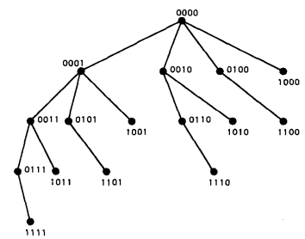
4-cube Spanning tree

Slide 8

Importance of Balance Factor
Balance factor is defined as the ratio of the sizes of the largest subtree of the root to that of the smallest subtree of the same root.
For a tree T, balance factor, that measures the efficiency in reachability and broadcastability of the root node across the tree, is denoted by BF(T).
It is desired that BF(T) be close to 1. The balance factor of a spanning tree can be calculated as

Slide 9
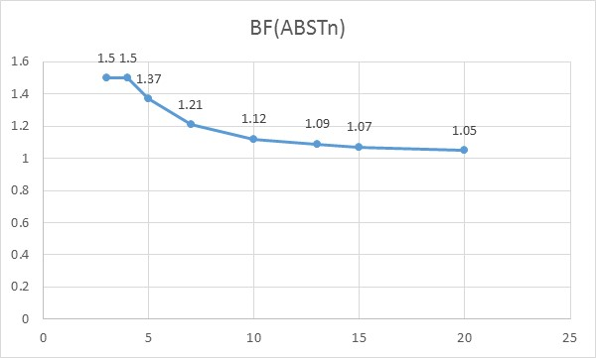
Balance factor with increasing number of nodes

Slide 10
Greedy Spanning Tree
The Greedy Spanning tree (GST) attempts to achieve minimum root to node distance while achieving optimal balance.
The tree is also known as the smallest misplaced first spanning tree.
Each child node is made by switching the first symbol with the other symbols in an ascending order.
The next switching occurs at the next level and the remaining permutations are implemented until either the last symbol is switched or the total number of nodes are achieved and arranged.

Slide 11
Simulation
Tool used
Topologies
Using rip created balanced spanning tree
Readings/comparison
Balanced tree with rip vs Topology with STA enable

Slide 12
3 cube Spanning tree
3 cube Binomial Spanning tree
No. of nodes | No. of Links | Degree
8 | 12 | 3
No. of nodes | No. of Links | Degree
8 | 7 | 1-3

Slide 13
3-star Spanning tree
3-star Binomial Spanning tree
No. of nodes | No. of Links | Degree
6 | 6 | 2
No. of nodes | No. of Links | Degree
6 | 5 | 1-2

Slide 14
No. of nodes | No. of Links | Degree
16 | 32 | 4
4-cube Spanning tree
No. of nodes | No. of Links | Degree
16 | 14 | 1-4
4-cube Binomial Spanning tree

Slide 15
4-star Binomial Spanning tree
4-star Binomial Spanning tree
No. of nodes | No. of Links | Degree
24 | 24 | 3
No. of nodes | No. of Links | Degree
24 | 19 | 1-3

Slide 16
Results
3 Cube
Normal Spanning Tree 3 Cube
Port 2 | Port 3 | Port 4 | Port 5 | Port 6 | Port 7 | Port 8
21 | 23 | 22 | 19 | 20 | 28 | 32
22 | 22 | 24 | 19 | 26 | 28 | 29
20 | 21 | 23 | 22 | 27 | 20 | 31
21 | 21 | 23 | 21 | 24 | 24 | 32
21 | 20 | 29 | 23 | 28 | 25 | 29
21 | 21.4 | 24.2 | 20.8 | 25 | 25 | 30.6
Balanced Spanning tree 3 Cube
Port 2 | Port 3 | Port 4 | Port 5 | Port 6 | Port 7 | Port 8
20 | 21 | 24 | 20 | 24 | 23 | 27
25 | 20 | 26 | 19 | 23 | 25 | 28
19 | 22 | 24 | 22 | 23 | 25 | 28
24 | 22 | 25 | 19 | 26 | 29 | 28
15 | 21 | 29 | 17 | 27 | 25 | 32
20.6 | 21.2 | 25.6 | 19.4 | 24.6 | 25.4 | 28.6

Slide 17
3 Star
Normal Spanning Tree 3 Star
Port 2 | Port 3 | Port 4 | Port 5 | Port 6
21 | 25 | 32 | 23 | 21
20 | 30 | 28 | 24 | 23
20 | 27 | 29 | 29 | 19
20 | 26 | 37 | 28 | 23
19 | 26 | 29 | 27 | 20
20 | 26.8 | 31 | 26.2 | 21.2
Balanced Spanning tree 3 Star
Port 2 | Port 3 | Port 4 | Port 5 | Port 6
19 | 27 | 33 | 25 | 20
22 | 29 | 32 | 25 | 20
21 | 25 | 25 | 30 | 22
21 | 27 | 30 | 24 | 19
21 | 19 | 32 | 23 | 22
20.8 | 25.4 | 30.4 | 25.4 | 20.6

Slide 18
4 Cube
 | Port 2 | Port 3 | Port 4 | Port 5 | Port 6 | Port 7 | Port 8 | Port 9 | Port 10 | Port 11 | Port 12 | Port 13 | Port 14 | Port 15 | Port 16
Normal Spanning Tree 4 Cube | 19.8 | 19.8 | 25.8 | 22.2 | 25 | 25.4 | 27 | 20.2 | 25.6 | 24.8 | 28.8 | 24.2 | 30.6 | 29.4 | 35.4
Balanced Spanning tree 4 Cube | 21 | 19.8 | 25.4 | 19.8 | 26.4 | 24.6 | 26.8 | 18 | 26 | 25.8 | 31.4 | 22.4 | 28.8 | 28.2 | 33.4

Slide 19
4 Star
 | Port 2 | Port 3 | Port 4 | Port 5 | Port 6 | Port 7 | Port 8 | Port 9 | Port 10 | Port 11 | Port 12 | Port 13 | Port 14 | Port 15 | Port 16 | Port 17 | Port 18 | Port 19 | Port 20 | Port 21 | Port 22 | Port 23 | Port 24
Normal Spanning Tree 4 Star | 19.6 | 25.8 | 33 | 24.6 | 20.2 | 19.4 | 23.6 | 27.4 | 33.4 | 28.2 | 24.2 | 34.8 | 32.2 | 31.6 | 31 | 26.2 | 30 | 29.8 | 24.4 | 29.6 | 34.8 | 30 | 35
Balanced Spanning Tree 4 Star | 20.8 | 27.4 | 28.6 | 24.2 | 20.6 | 20.4 | 24 | 26 | 35.6 | 29.4 | 25.4 | 32.2 | 30 | 31.4 | 30.4 | 24.8 | 29.6 | 28.6 | 25.8 | 26.8 | 31.8 | 29.2 | 32

Slide 20
Conclusion
The simulation through disabling links and creating balanced spanning tree along with the use of RIP protocol, is feasible and enables us to demonstrate efficient response time.
The simulation also showcased the physical aspect of the theory which is network topology and spanning trees.

